Slide 1

CAMPUS
NAVIGATION

Slide 2
CONTENTS
PROBLEM STATEMENT
MODULARIZATION OF PROBLEM STATEMENT
DESIGN METHODOLGY
SOFTWARE & HARDWARE REQUIREMENT
TEST CASE SPECIFICATION
SCREENSHOT OF SPECIFICATION
CONCLUSION

Slide 3
PROBLEM STATEMENT:
Navigating college campuses, especially for new comers and during events, poses significant challenges due to their intricate layouts and reliance on outdated static maps. Current solutions lack real-time updates, resulting in frustrations and inefficiencies for users. There is a pressing need for a new campus navigation system that offers dynamic, customized routes tailored to address issues like construction, accessibility concerns, and individual preferences. Such a system would significantly enhance the overall campus navigation experience, ensuring smoother and more efficient journeys for all users.

Slide 4
MODULARIZATION OF PROBLEM STATEMENT:
1. Requirement Analysis:
Gather requirements from stakeholders including students, faculty, administration, and visitors.
Identify key features and functionalities based on user needs and pin points.
2. User Experience (UX) Design:
Develop user personas representing different user types and their navigation preferences.Design intuitive user interfaces for map display, destination selection, and search functionality.Create wireframes and prototypes to visualize the user journey and interaction flow.
3. Map Integration:
Select a mapping service such as Google Maps or Leaflet.js for displaying campus maps.Customize map displays to include key landmarks, buildings, pathways, and points of interest (POIs).

Slide 5
MODULARIZATION OF PROBLEM STATEMENT:
4. Geolocation Integration:
Implement Geolocation API to automatically detect the user's current location upon accessing the application.
Ensure privacy and security measures are in place for handling user location data.
5. Destination Selection:
Enable users to select their destination within the campus through map interaction or a list of predefined locations.
Implement intuitive controls for users to easily choose their desired destination.
6. Routing Algorithm:
Develop a routing algorithm to generate step-by-step directions from the user’s current location to their selected destination. Incorporate real-time data on construction, closures, and accessibility to optimize routing.
7. Search Functionality:
Integrate a search feature allowing users to search for specific buildings, facilities, or landmarks within the campus.
Implement autocomplete suggestions for efficient and accurate search results.

Slide 6
MODULARIZATION OF PROBLEM STATEMENT:
8. Favorite Locations Management:
Provide users with the ability to save their favorite locations or frequently visited spots within the campus.
Enable users to easily access and manage their saved locations for quick navigation.
9. User Feedback Integration:
- Implement a feedback mechanism for users to provide input on the application's usability, accuracy, and features.
- Regularly review and incorporate user feedback to improve the application’s performance and user satisfaction.

Slide 7
Software & Hardware Requirements:~
Hardware Requirements:
1.Server Infrastructure : Sufficient computational resources to host the application backend, database, and APIs. Scalable infrastructure to handle varying loads during peak usage times.Reliable network connectivity to ensure uninterrupted service availability.
2. Client Devices: Desktop computers, laptops, smartphones, and tablets for accessing the campus navigation system.Compatible web browsers or mobile applications for accessing the system interface.
3. GPS-enabled Devices: Smartphones or tablets equipped with GPS capabilities for accurate location detection. GPS receivers with high accuracy for use in specific scenarios where precise location information is required.

Slide 8
Software & Hardware Requirements:~
Software Requirements:
1. Backend Technologies: Programming Languages: JavaScript (Node.js) for backend development. Database: MongoDB for storing map data, user information, and preferences. Geolocation Services: Integration with Geolocation APIs (e.g., Google MapsGeolocation API) for location detection and leaflet API.
2. Frontend Technologies:Web Development: HTML,CSS, JAVASCRIPT,REACTJS, BOOTSTRAP forbuilding responsive web interfaces.
3. Mapping Services: Integration with mapping services such as Google Maps, Leaflet.js, or Mapboxfor displaying campus maps and routing information. Access to mapping APIs for retrieving map data, displaying markers, and generating directions.
4. User Interface Design Tools:Design tools like Figma for creating wireframes, maps,Blueprints, and user interface designs.

Slide 9
Test Case Specification:
1. Map Display:
Test Case 1: Verify that the campus map loads correctly upon accessing the application.
Test Case 2: Check that key landmarks, buildings, and pathways are displayed accurately on the map.
Test Case 3: Ensure smooth navigation and zoom functionality within the map interface.
2. User Location Detection:
Test Case 1: Verify that the Geolocation API accurately detects the user’s current location.
Test Case 2: Check for compatibility across different devices and browsers.
3. Destination Selection:
Test Case 1: Verify that users can select their destination by clicking on the map.
Test Case 2: Check that users can also choose from a list of predefined destinations.
Test Case 3: Ensure the selected destination is accurately reflected in the routing algorithm.

Slide 10
Test Case Specification:
4. Step-by-Step Directions:
Test Case 1: Verify that users receive accurate step-by-step directions to their destination.
Test Case 2: Check that landmarks or key points are included in the directions for easy navigation.
Test Case 3: Ensure the directions are updated in real-time to account for any changes in route or conditions.
5. Search Functionality:
Test Case 1: Verify that users can search for specific buildings, facilities, or landmarks within the campus.
Test Case 2: Ensure users can get directions to the searched location from their current position.
6. Save Favorite Locations:
Test Case 1: Verify that users can save their favorite locations within the campus.
Test Case 2: Check that saved locations are accessible for quick access in the future.
Test Case 3: Ensure users can manage and delete saved locations as needed.
7. Active Users Location:
Test Case 1: Verify that the administration can view the real-time location of active users.
Test Case 2: Ensure the location tracking system operates efficiently and accurately.

Slide 11
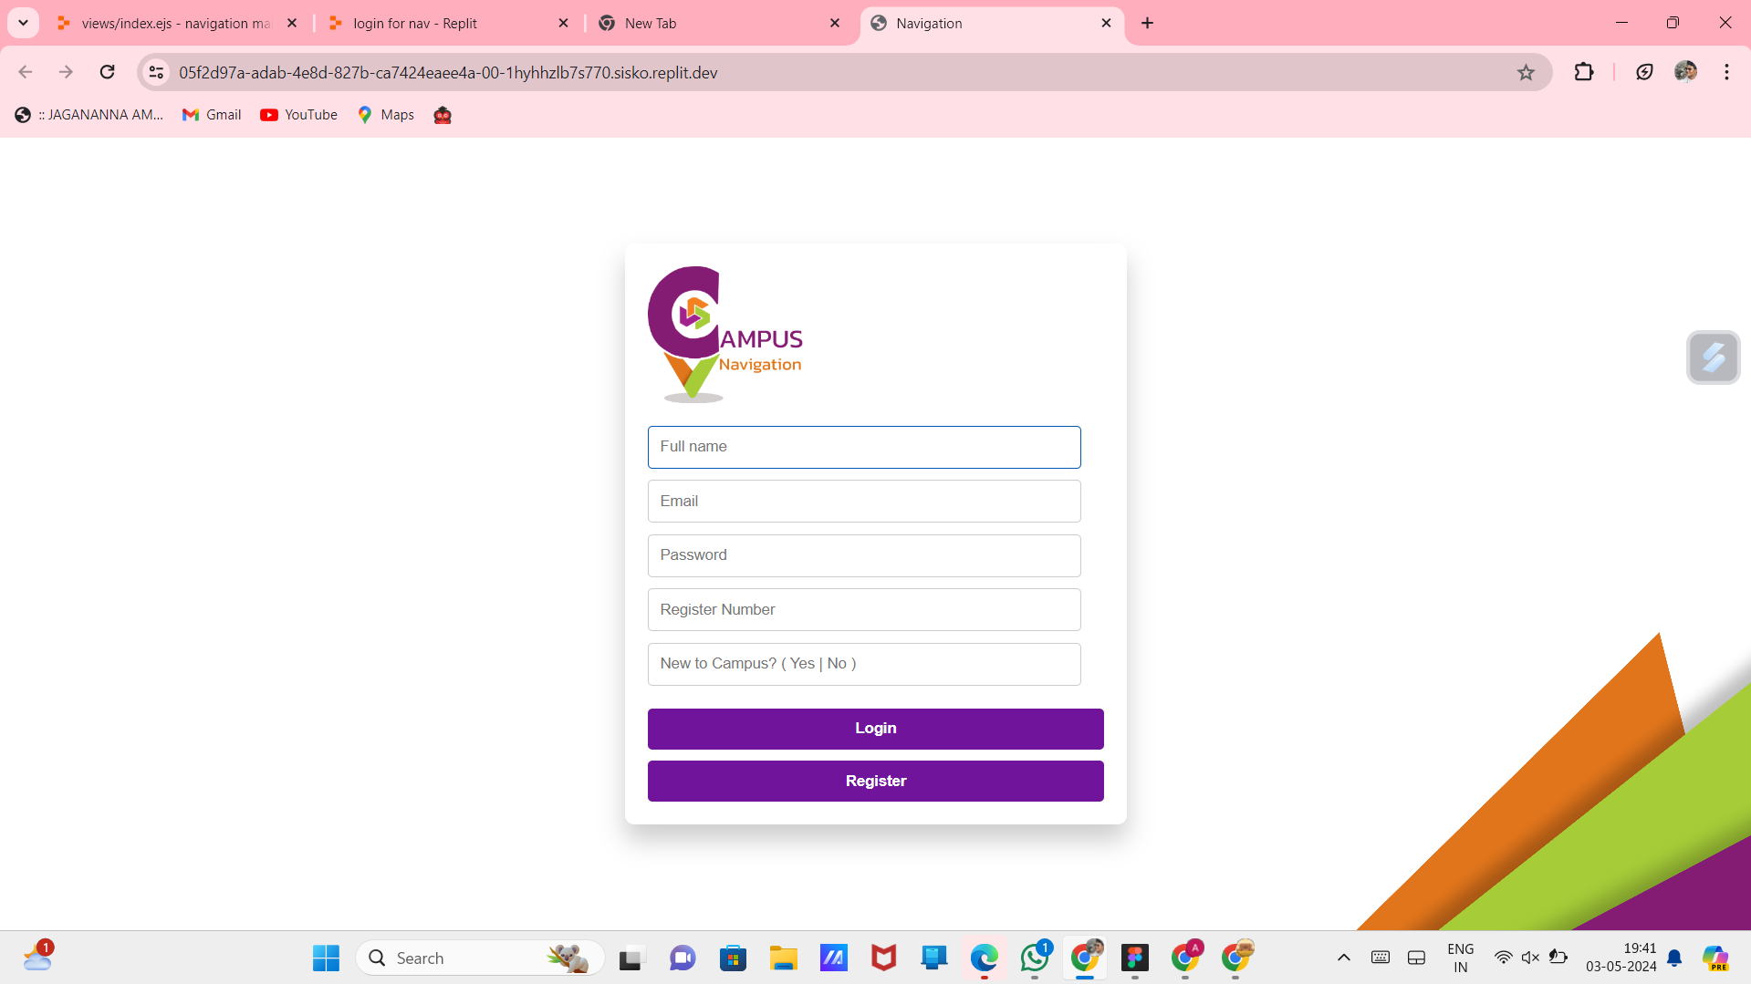
OUTPUT:

Slide 12
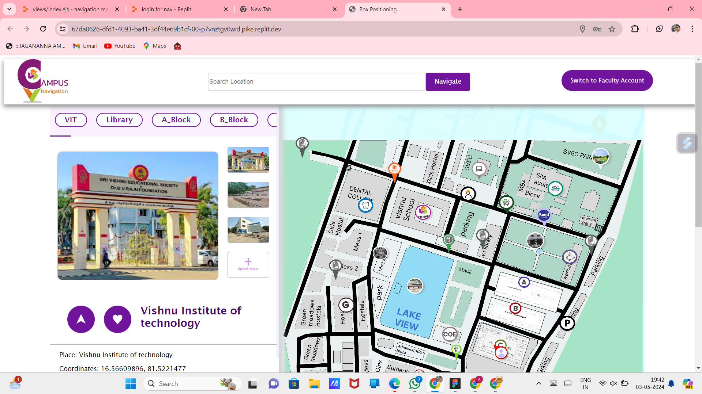
OUTPUT:

Slide 13
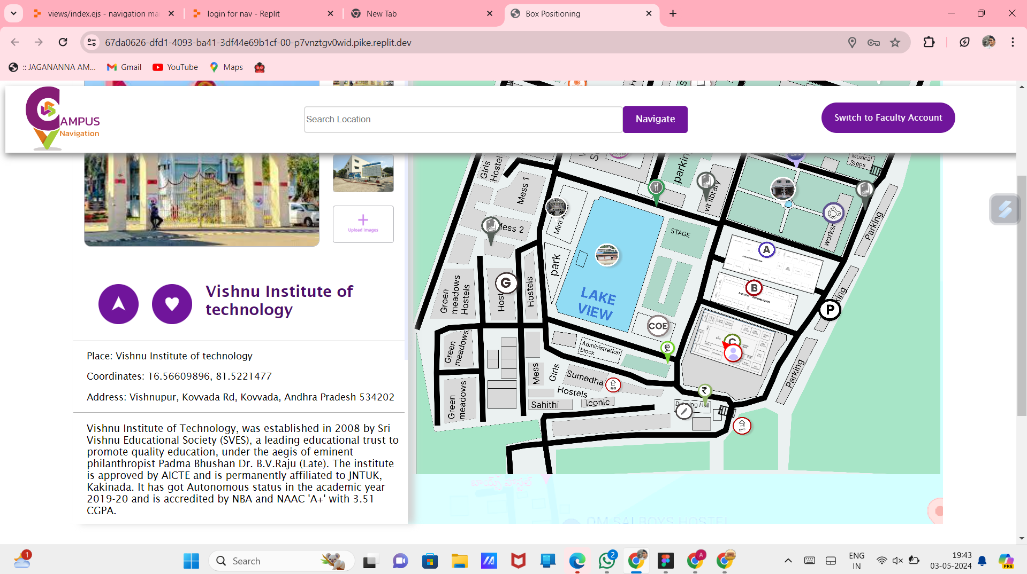
OUTPUT:

Slide 14
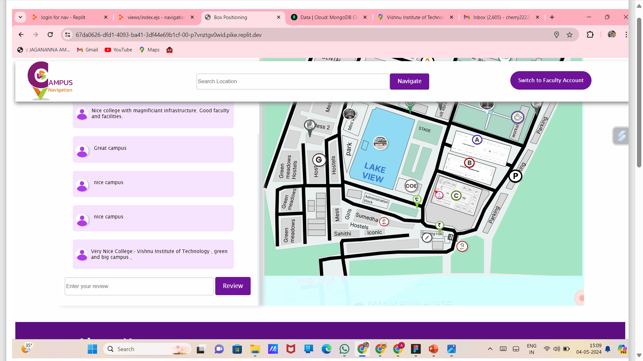
OUTPUT:

Slide 15
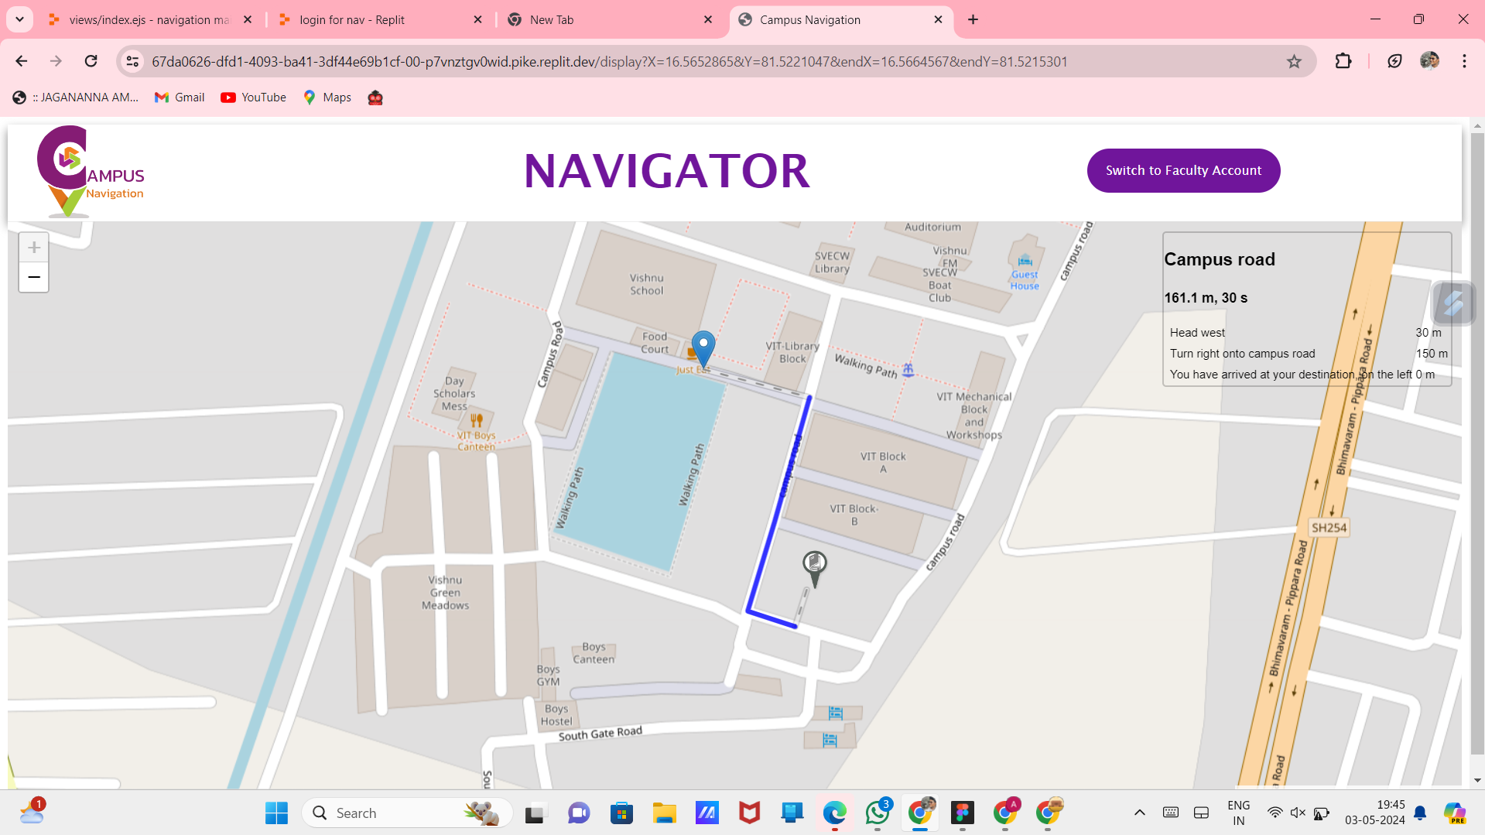
OUTPUT:

Slide 16
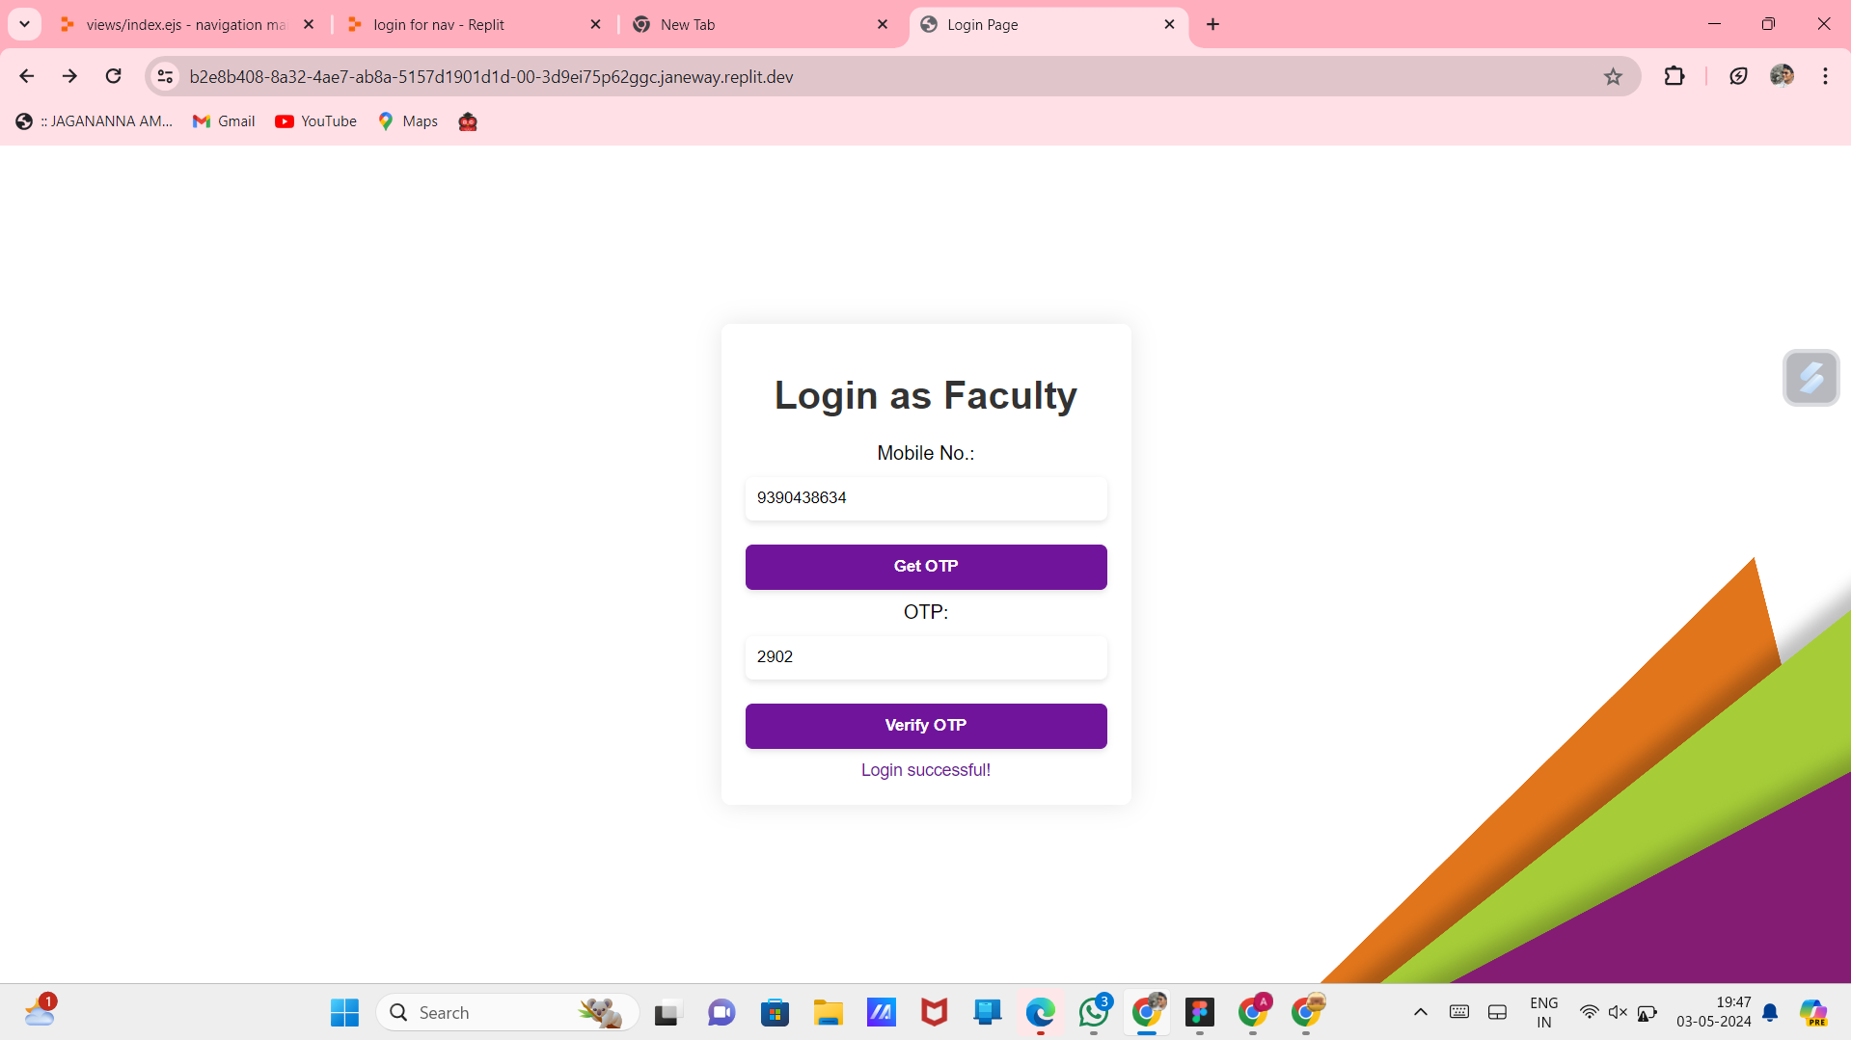
OUTPUT:

Slide 17
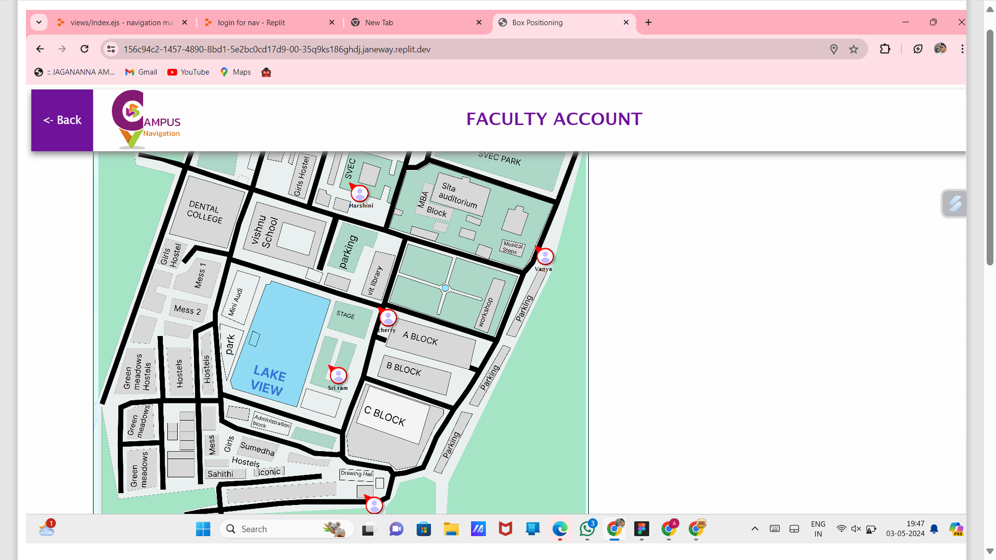
OUTPUT:

Slide 18
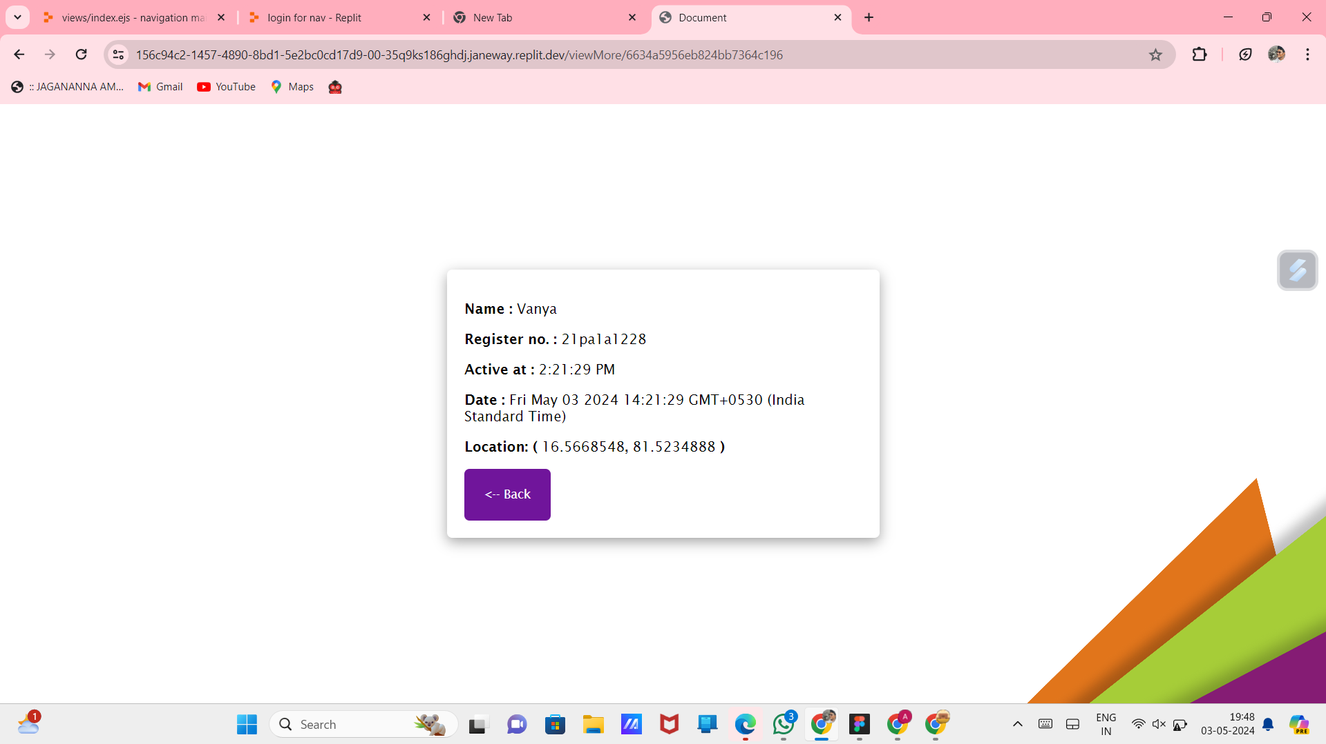
OUTPUT:

Slide 19
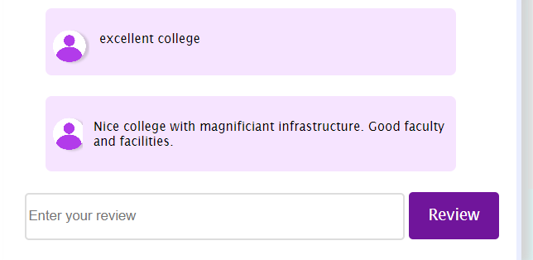
OUTPUT:

Slide 20
CONCLUSION
A campus navigation project using HTML, CSS, JavaScript , Bootstrap, MongoDB, and the Geolocation API provides a valuable service to users by helping them navigate around a campus or large area efficiently. By implementing key features such as map display, route generation, and step-by-step directions, the application can enhance the user experience
Notes:
gettyimages-1061332616-2048x2048

